Slide 1
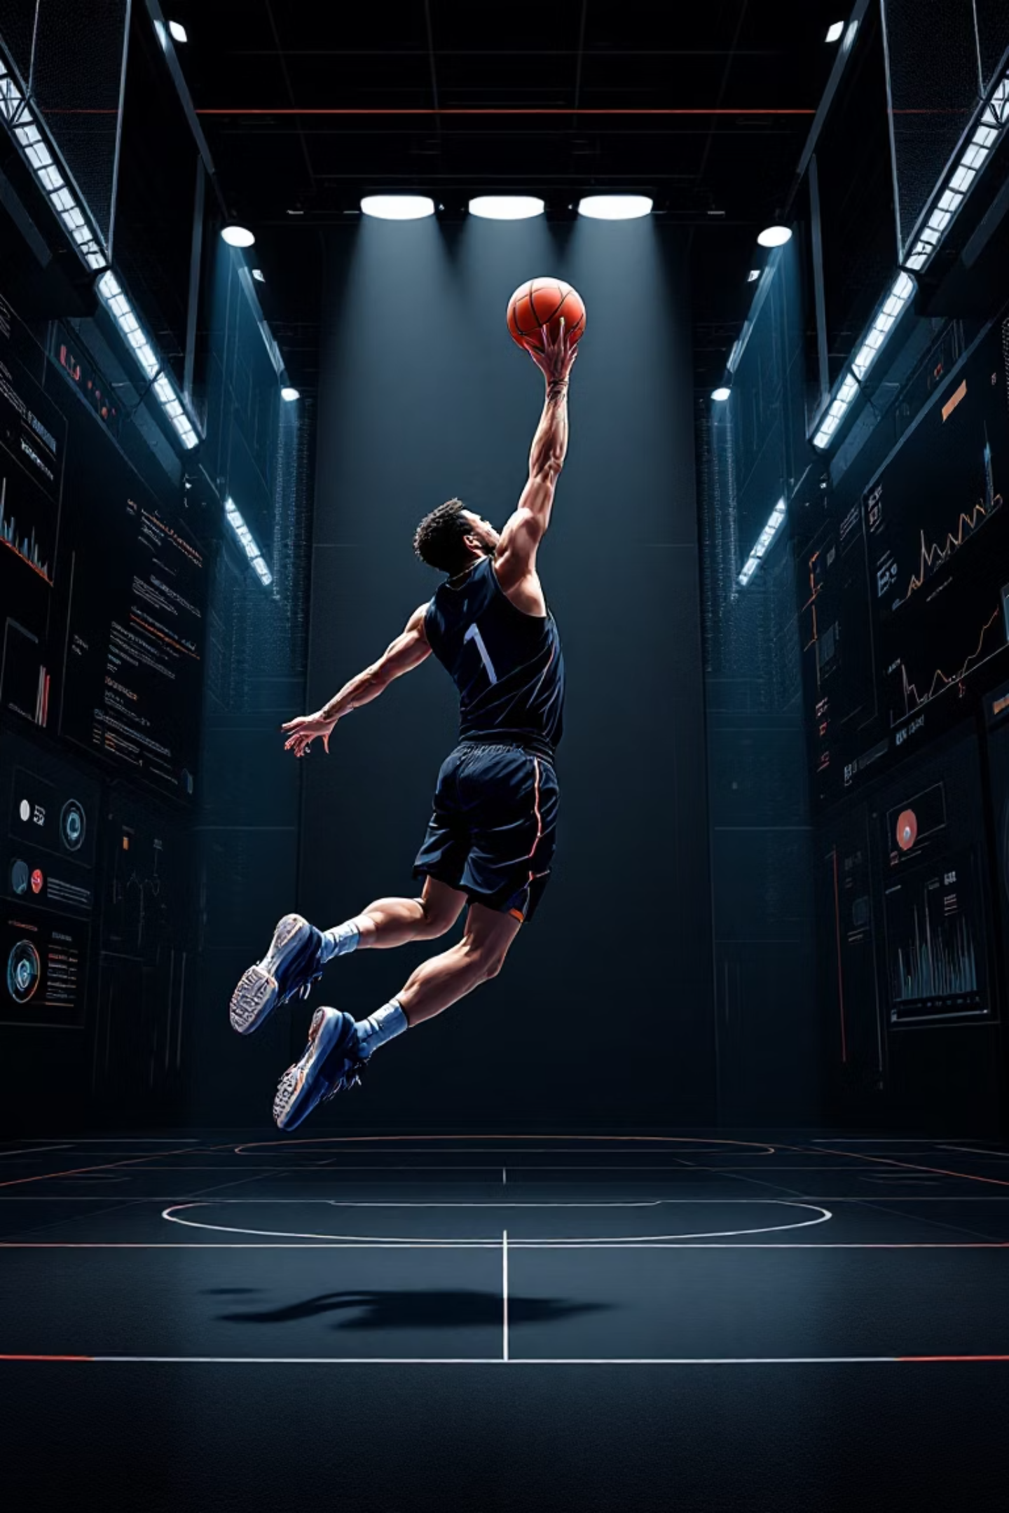
Vision-Based Basketball Shot Detection and Form Evaluation

Slide 2
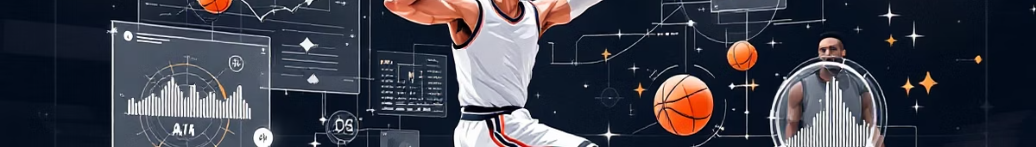

Project Objective: What Does It Do?
Our project is an AI Basketball Coach that analyzes video footage of a player to provide real-time, actionable feedback on both performance and technique.
Tracks the Score
Judges Each Shot
Automatically counts "Makes" vs. "Attempts" throughout your entire practice session
Displays instant "MAKE" or "MISS" feedback on-screen for every attempt
Analyzes Shooting Form
Provides Final Report
Calculates a "Form Confidence" score (0-100) based on body mechanics and technique
Delivers comprehensive summary with shooting percentage and average form breakdown

Slide 3
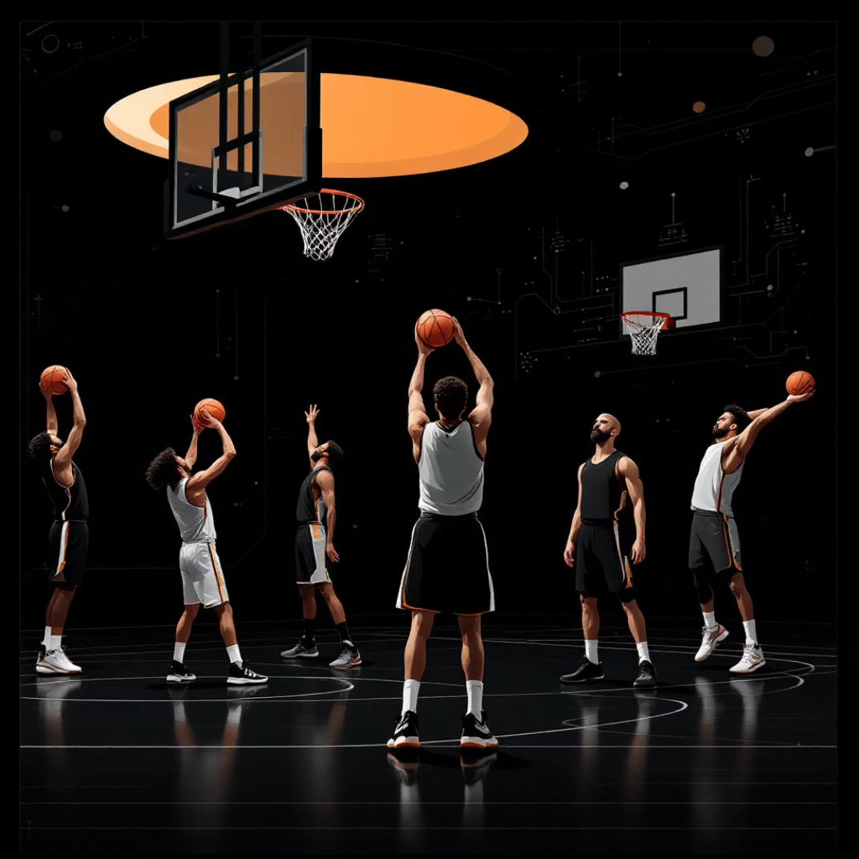
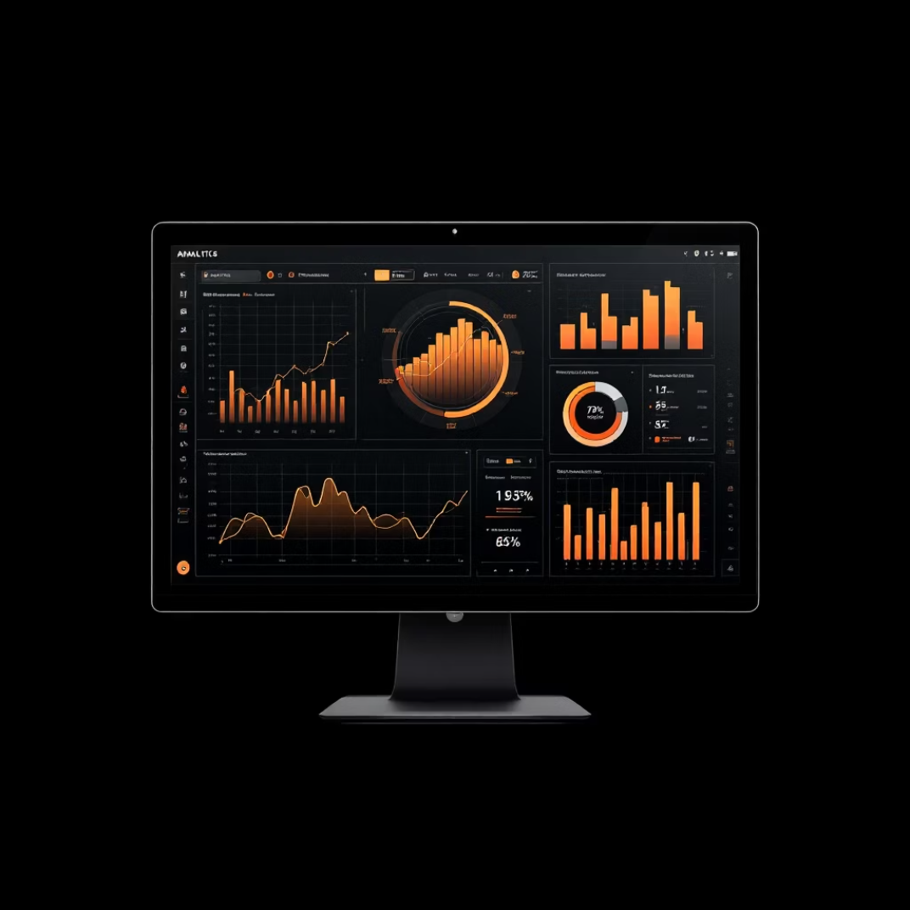
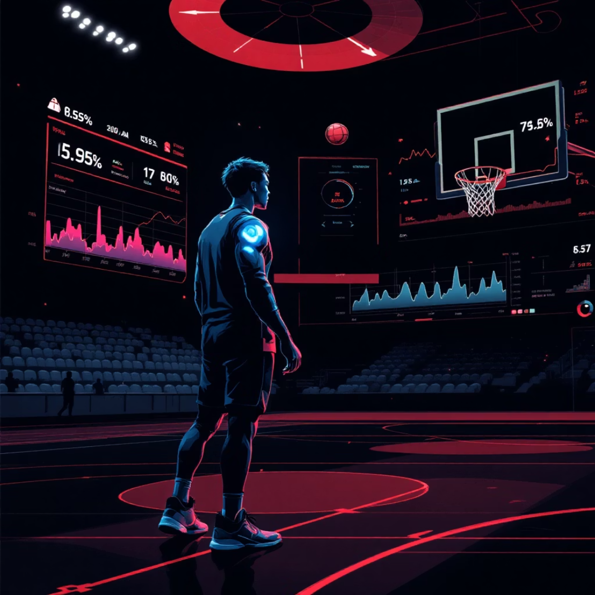
Our Motivation: Why Build This?
Democratize Coaching
Objective Data
Faster Feedback
Professional one-on-one shot training is expensive and inaccessible to most players. We wanted to create a free, virtual coach that anyone can use with just their phone's camera.
Players often rely on "feel," which can be misleading. Our system provides hard, unbiased data on shooting percentage and form consistency, enabling targeted, data-driven practice.
The key to building muscle memory is immediate correction. By seeing results and form scores instantly, players can adjust their next shot far more effectively.

Slide 4
The "How": 4 Approaches We Considered
We needed to reliably track the ball, the hoop, and the player's body. Here's how we evaluated different technical solutions:
01
02
Manual Calibration
Traditional CV (Hough Circles)
Having the user pause video and manually draw a circle on the hoop. Rejected: Clunky, time-consuming, and fails if camera moves.
Using classic OpenCV functions to find the circular rim shape. Rejected: Highly unreliable across different lighting, angles, and obstructions.
03
04
Single Complex Model
Specialized Dual-Model ✓
Training one massive AI to find ball, hoop, and all 33 body landmarks. Rejected: Requires enormous dataset, very slow, and lacks specialization.
Our Choice: YOLOv8 for object detection (ball, hoop) + Mediapipe Pose for body tracking. Most robust and efficient—each model excels at its specific task.

Slide 5
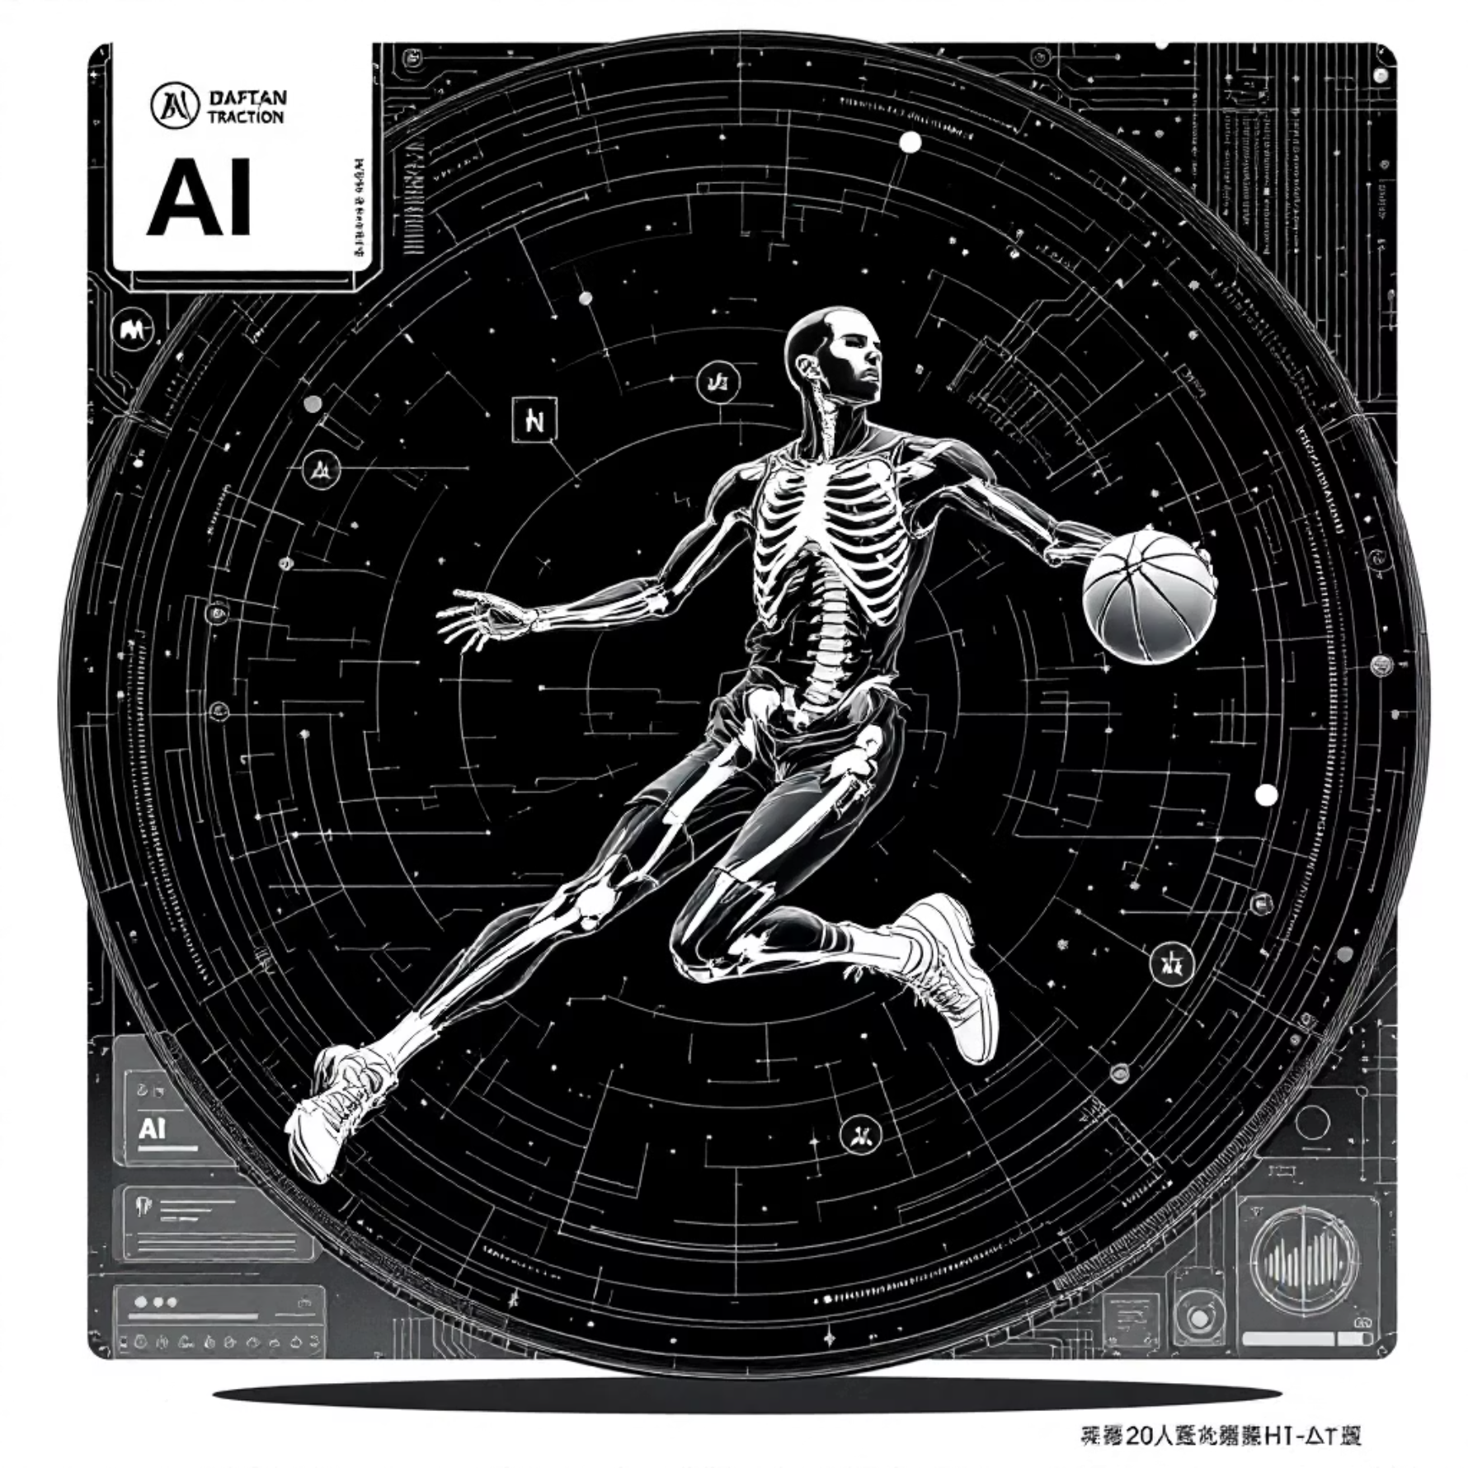
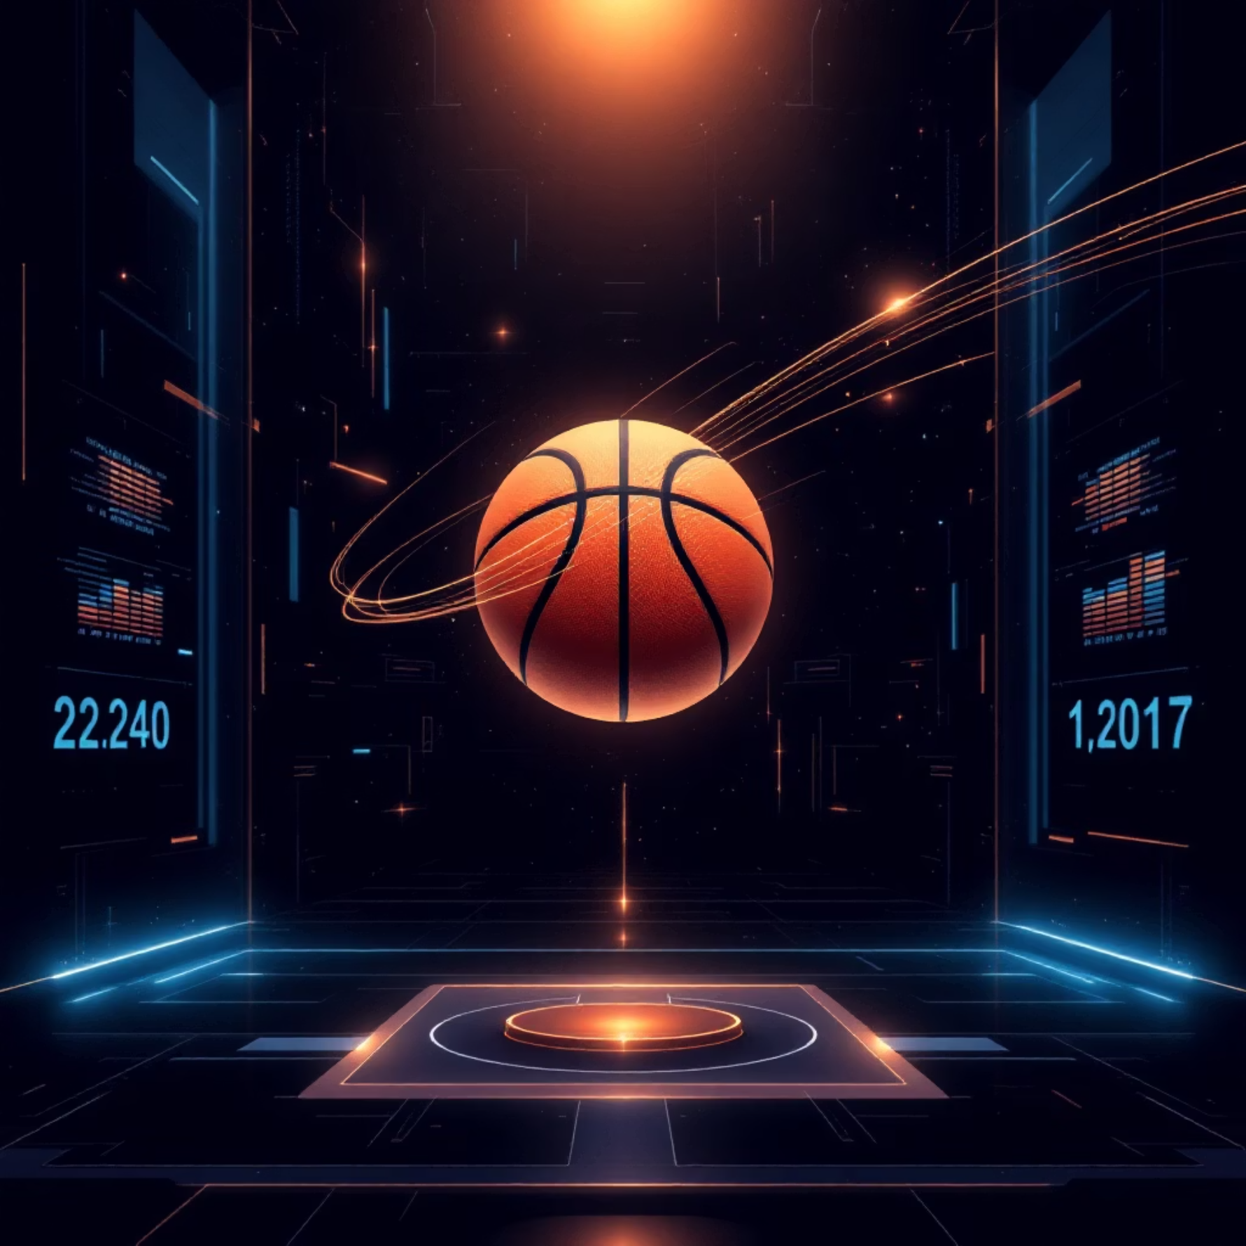
Our "Secret Sauce": How It All Works Together
The intelligence comes from how our two AI models communicate and coordinate in real-time:
Form Detector (Mediapipe)
Shot Detector (YOLO)
Continuously tracks the player's body landmarks
Continuously tracks ball and hoop position
Detects shooting motion (elbow extension + wrist snap)
Waits for ball to travel above then below rim
Calculates and saves Form Score (0-100)
Confirms an "Attempt" has occurred
Shot Detected
Path Analyzed
Shot Detector confirms attempt
Checks if ball center entered hoop circle
1
2
3
4
Form Retrieved
Result Displayed
Grabs last saved Form Score
Shows "MAKE/MISS" + "Form: 92/100"

Slide 6

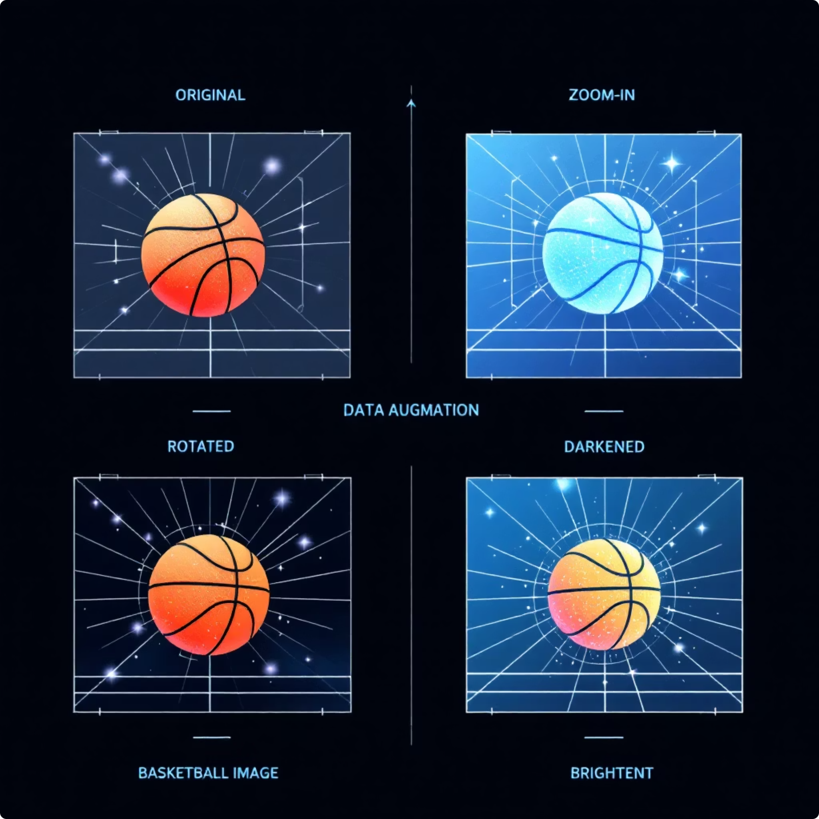
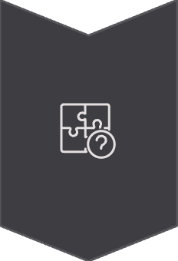

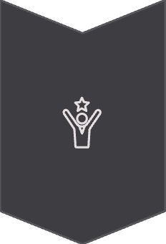
Forging Our "Expert Eye": The best.pt Story
The standard YOLO model recognizes 80 objects, but we needed a basketball specialist that could reliably detect only what matters: the ball and the hoop.
The Problem
Standard model was slow and frequently confused the hoop with other circular objects or missed it entirely at different angles.
The Solution: Roboflow
Data Sourcing: Gathered extensive basketball dataset from Roboflow Universe with two classes: Basketball and Basketball Hoop
Augmentation: Automatically created training variations through flipping, rotating, and brightness adjustments
Training: Fine-tuned YOLOv8n (nano) architecture to create our specialized best.pt model
The Result
Our best.pt is a lightweight expert—faster and far more accurate at detecting only ball and hoop than the generic model.

Slide 7
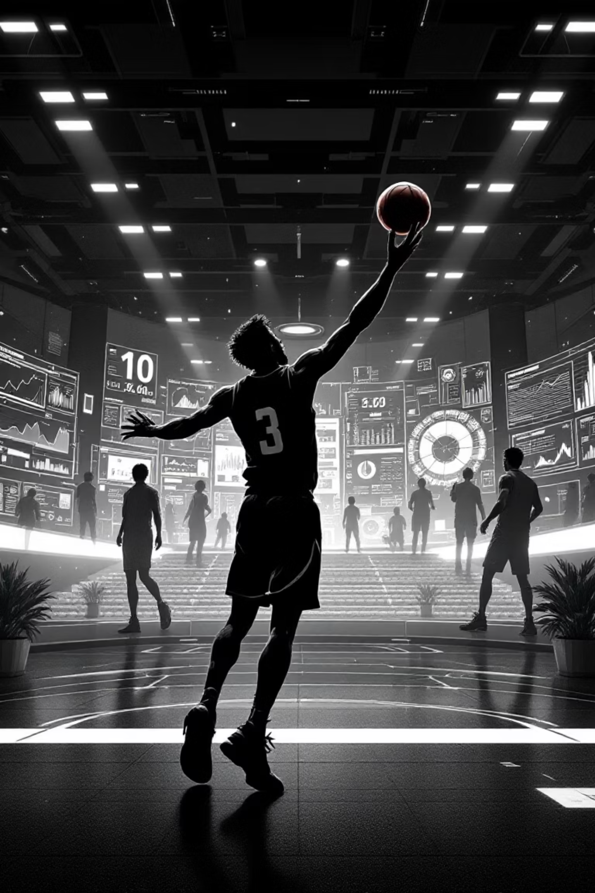
Final Summary
Our system successfully merges two distinct AI models to create a single, seamless user experience that answers not just "Did it go in?" but also "How was my form?" for every single shot.
Key Achievement
2
We've created a complete feedback loop that paves the way for more accessible, data-driven athletic training. By combining computer vision and pose estimation, we deliver professional-grade coaching insights that were previously only available through expensive one-on-one sessions.
AI Models
Working in perfect harmony
100%
Real-Time
Instant feedback on every shot
0
Cost
Free virtual coaching for all
Questions?

